Slide 1
Walkthrough
1) Introduction to python
what is python
why python
setting up environment for python
What is jupyter notebook
Brief of jupyter notebook
Writing first code in jupyter notebook
Quiz and Exercise
2) Python Variables and Keywords
python keywords
declaring and assigning values to variables
Math Operators and expressions
Operations on variables
Comments and document in python
Quiz and Exercise

Slide 2
What is Python and History of python
1) Python was developed by Guido van Rossum in the late 1980s.
2) Python is an interpreted, object oriented , high level programming language.
3) Python has easy to learn language and syntax.
4) There is no compilation stage in python. The code is directly converted to machine understandable.
5) Supported on multiple platforms and has extensive standard libraries like, TensorFlow, Scikit-Learn, Numpy, Keras, Scipy.
6) The current latest version of python is 3.7.2

Slide 3
INTRODUCTION TO PYTHON

Slide 4
Why Python and Where to use it
Readable and Maintainable code : Use simple English like keywords and punctuations
Helps in developing large and complex software applications
Allows us to run same code on different systems.
Easier to make changes in the code without increasing the development time.
It has large and robust libraries.
Many open source framework and tools, like Numpy, scipy, scikit learn etc for machine learning and data analytics.

Slide 5
Setting up python environment and Installing Anaconda
Go to website : https://www.python.org/downloads/
Click on the downloads section and click on windows.
Select python 3.7.1 executable installer.
Open the file and click on Install now.
Once the installation is complete, open cmd prompt and check for python –v.
Install anaconda, for writing python programs .
Go to website : https://www.anaconda.com/downloads/
Download Anaconda for python version 3.7.
Open the jupyter notebook on local host 8889.
Start writing the code.

Slide 6
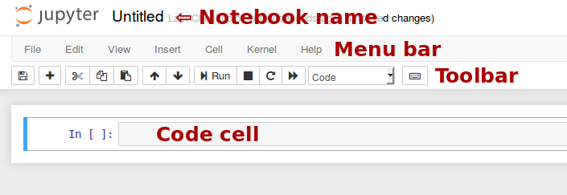
Anaconda Navigation
Discussing various Headings under Jupyter Notebook:

Slide 7
Some Key Functions of Jupyter Notebook
Escape takes to command mode and enter takes back to the edit mode
Command Mode (press Esc to enable)Edit Shortcuts
F: find and replace
Ctrl-Shift-F: open the command palette
Enter: enter edit mode
P: open the command palette
Shift-Enter: run cell, select below
Ctrl-Enter: run selected cells
Alt-Enter: run cell and insert below
Y: change cell to code
M: change cell to markdown
R: change cell to raw
1: change cell to heading 1
2: change cell to heading 2

Slide 8
Shift-Up: extend selected cells above
Shift-Down: extend selected cells below
A: insert cell above
B: insert cell below
X: cut selected cells
C: copy selected cells
Shift-V: paste cells above
V: paste cells below
Z: undo cell deletion
D,D: delete selected cells
Shift-M: merge selected cells, or current cell with cell below if only one cell is selected
Ctrl-S: Save and Checkpoint
S: Save and Checkpoint
L: toggle line numbers
Shift-O: toggle output scrolling of selected cells

Slide 9
Edit Mode (press Enter to enable)
Ctrl-]: indent
Ctrl-[: dedent
Ctrl-A: select all
Ctrl-Z: undo
Ctrl-/: comment
Ctrl-D: delete whole line
Ctrl-U: undo selection
Ctrl-M: enter command mode
Ctrl-Shift-F: open the command palette

Slide 10
Writing First Python Program:
Print (“Hello World, I am learning python”)
A= 4
B= 5
C= A+B
Print (C)
def example(x):
print ('Hello :'+ x)
example(‘World')

Slide 11
PYTHON VARIABLES AND KEYWORDS

Slide 12
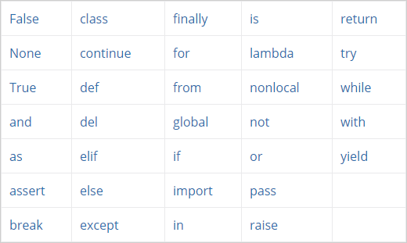
Python Keywords
List of python Keywords:

Slide 13
Rules for writing Identifiers:
1) Identifiers can be a combination of letters in lowercase (a to z) or uppercase (A to Z) or digits (0 to 9) or an underscore _. Names like myClass, var_1 and print_this_to_screen, all are valid example.
2) An identifier cannot start with a digit. 1variable is invalid, but variable1 is perfectly fine.
3) Keywords cannot be used as identifiers.
4) We cannot use special symbols like !, @, #, $, % etc. in our identifier.
5) Identifier can be of any length.

Slide 14
Declaring and Assigning values to the variables
A variable is a named location used to store data in the memory. It is helpful to think of variables as a container that holds data which can be changed later throughout programming.
To check the identity of the variable we use print (id(x))
We can change the value of the variable at any time. In that case the earlier value of the variable will be replaced.
To check the type of the variable use type(x)
We can assign multiple values to multiple variables at the same time.
If we try to assign multiple values to the same variable, it creates a tuple.

Slide 15
Literals in Python
Literal is a raw data given to a variable in python.
3 types of literals : Numeric, String and Boolean,
Numeric Literals:
Numeric literals can belong to 3 different categories, int, float, complex
If we create complex variable then we can extract the real part as x.real and imaginary part as x.imag
String Literals: It is a sequence of characters surrounded by quotes.
Boolean literals: A boolean literal can have any one of the two values True, False
Literal Collection: Lists, Tuples and Dictionary

Slide 16
Mathematical Operators and Expressions
Various Mathematical Operators in Python:
Arithmetic Operators
Comparison Operators
Assignment Operators
Logical Operators
Membership Operators
Identity Operators

Slide 17
Operators Precedence
Operators (Decreasing order of precedence) | Meaning
** | Exponent
*, /, //, % | Multiplication, Division, Floor division, Modulus
+, - | Addition, Subtraction
<= < > >= | Comparison operators
= %= /= //= -= += *= **= | Assignment Operators
is is not | Identity operators
in not in | Membership operators
not or and | Logical operators

Slide 18
Operation on Strings
Following are the operation on strings:
s.lower(), s.upper()
s.strip(), s.lstrip(), s.rstrip()
s.isalpha()/s.isdigit()/s.isspace()
s.startswith('other'), s.endswith('other')
s.find('other')
S.count(‘other’)
s.replace('old', 'new')
s.split('delim')
‘delimiter’.join(list)
String slices

Slide 19
Comments in Python
Comments in python are written as follows:
#This would be a comment in Python
“”” This would be a multiline comment in Python that spans several lines and describes your code, your day, or anything you want it to … “””

